Slide 1



Slide 2

Migration
Zuzana Jandová
Matěj Chalupka
students

Slide 3
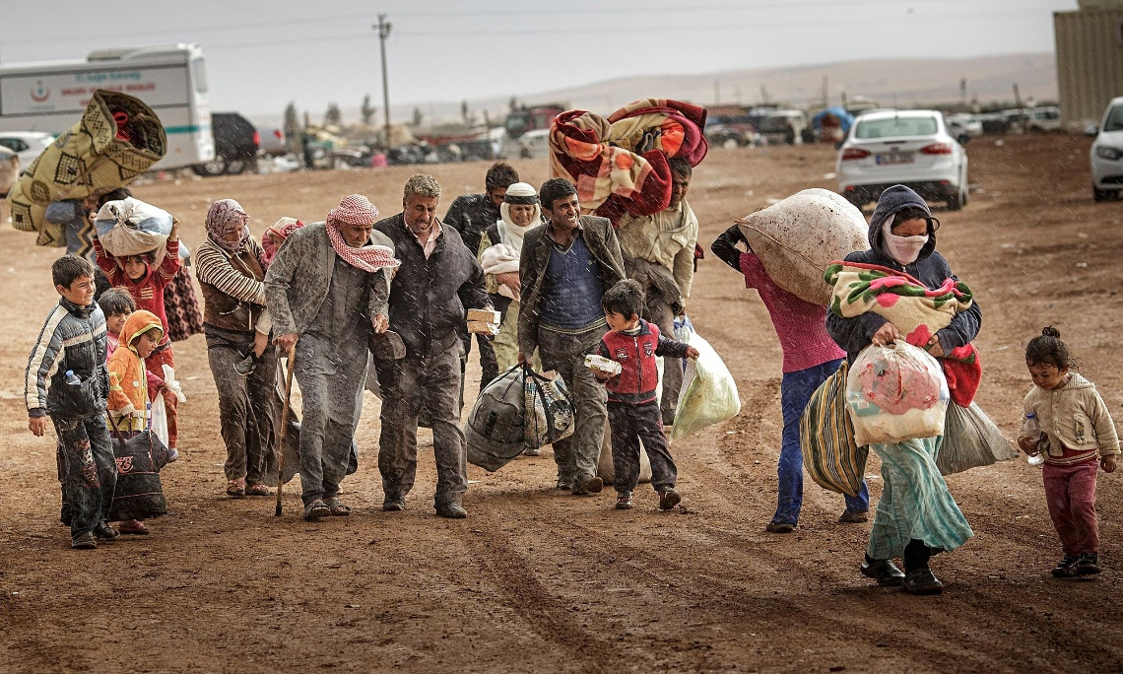
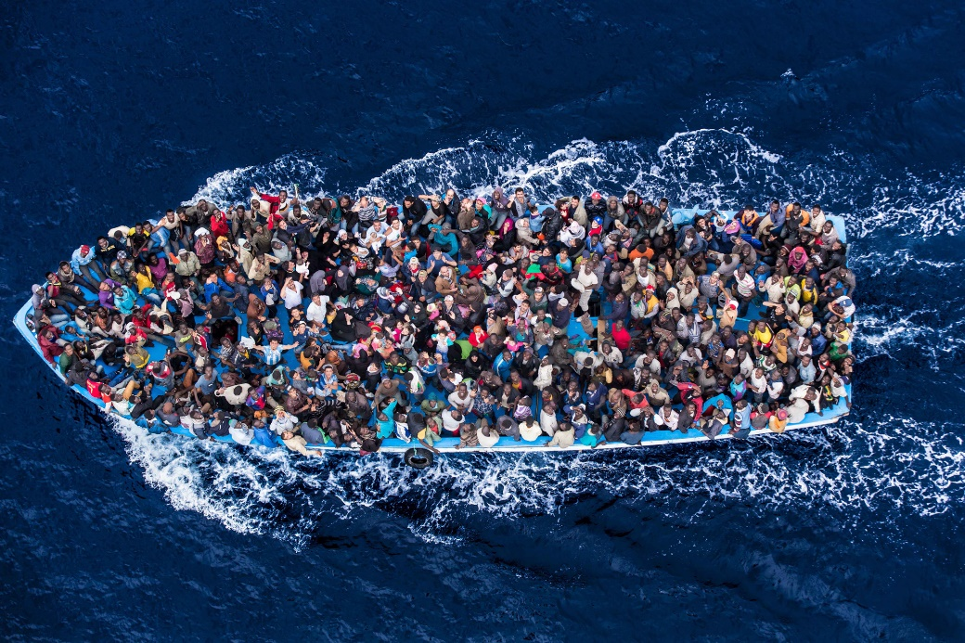
International facts
In 2016 – 66 milion of refugees
51 % younger than 18 years old
On journey 5096 men, women and kids have died in 2016

Slide 4
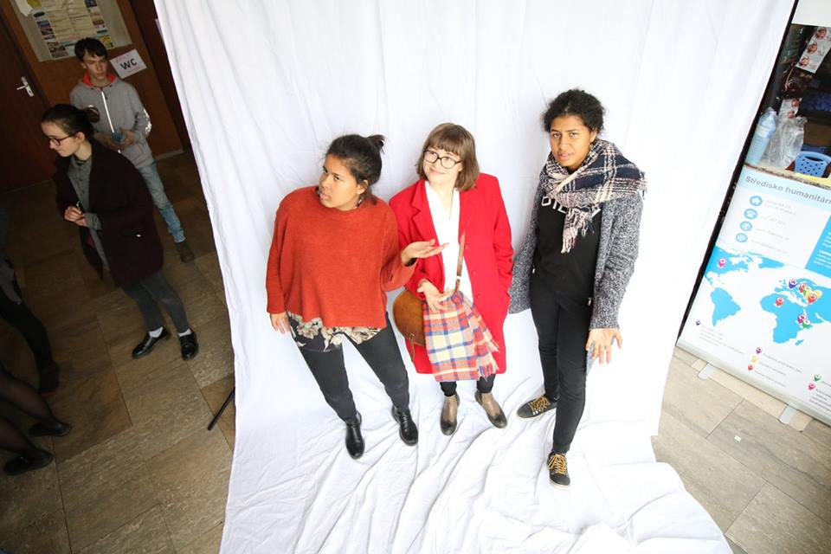
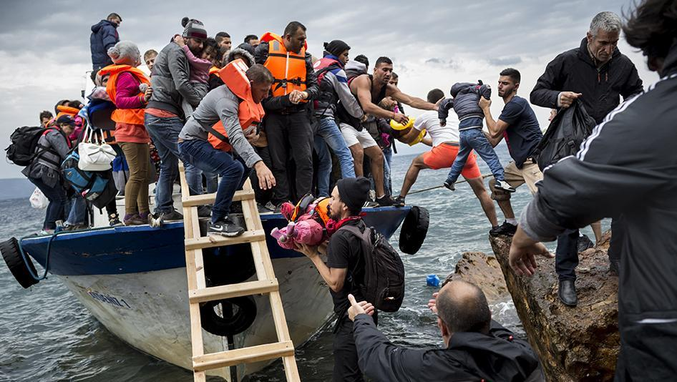
Migrants vs refugees
MIGRANTS
REFUGEES
They leave their country because of jobs, economic problems or education.
They escape because of some dangerous situations (war, famine..)

Slide 5
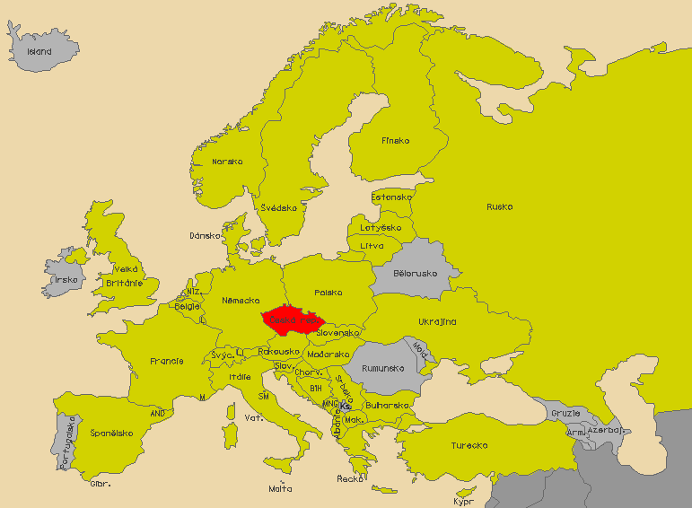
Emigration vs immigration
EMIGRATION
IMMIGRATION
We go somewhere…
They come to our country…

Slide 6

Czech Republic and refugees
There are our 12 legal accepted refugees….who stay here
There are other refugees – less than 5000 continuing to other states

Slide 7
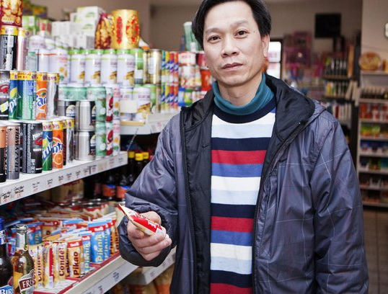
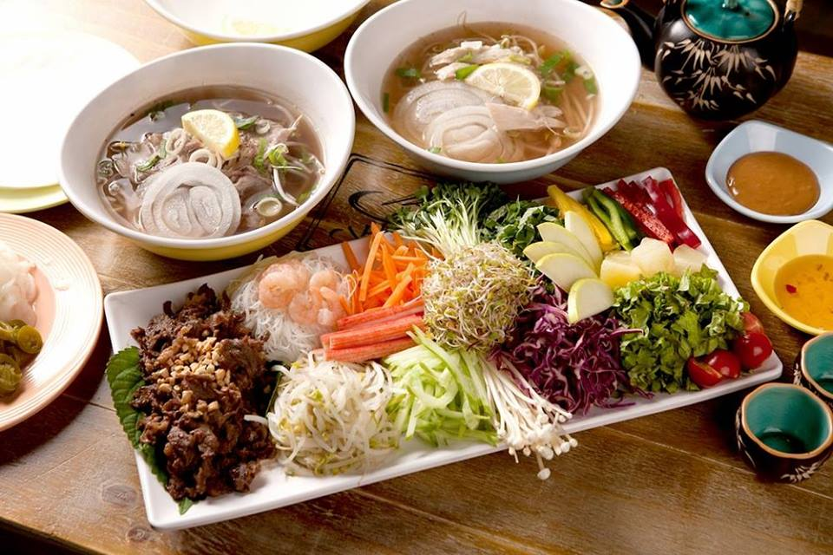
Minorities in Czech Republic
Vietnamese minority
  Over 60 000 habitants
  Good shop keepers
  Clever kids
  Hardworking
  Delicious food

Slide 8
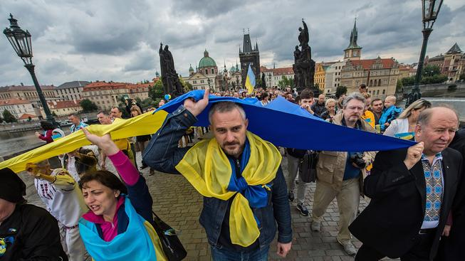
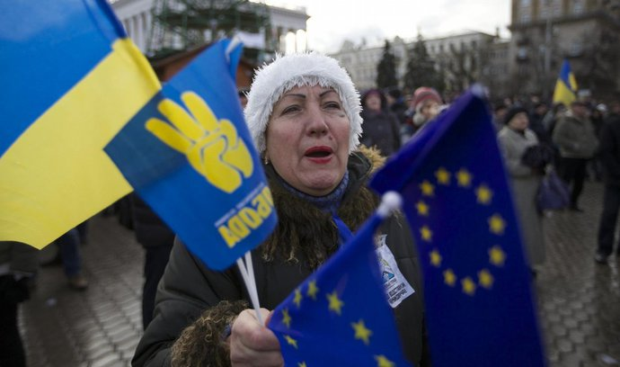
Minorities in Czech Republic
Ukraninian minority
  Over 100 000 habitants
  Hardworking
  Typical jobs (welder, cleaner, construction,…)

Slide 9
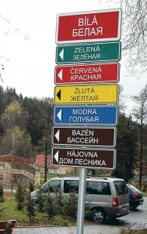
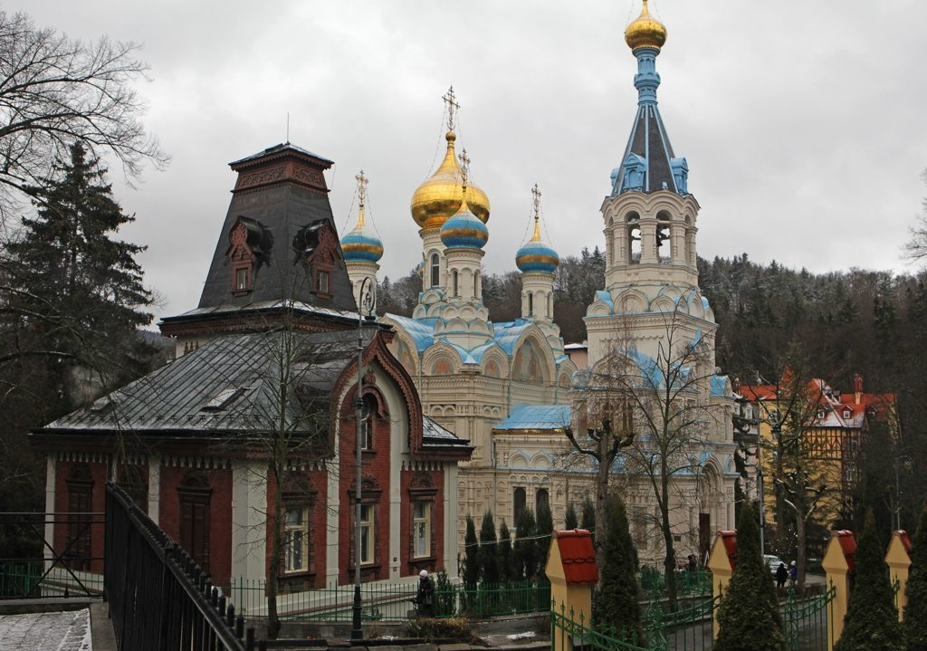
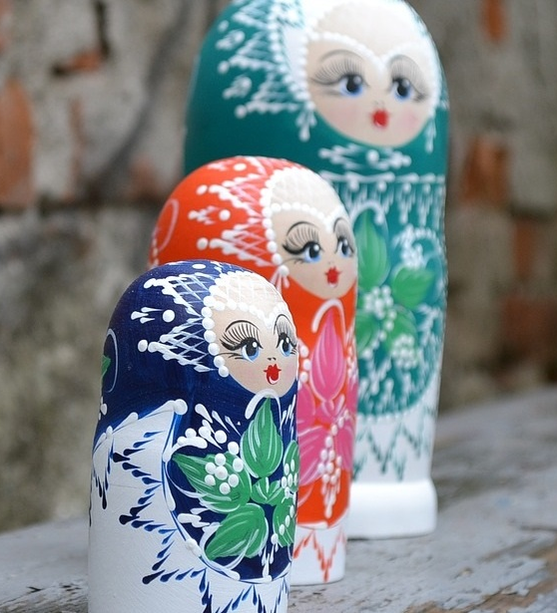
Minorities in Czech Republic
Russian minority
  Karlovy Vary
  After Velvet revolution
  Wealthy Russians

Slide 10
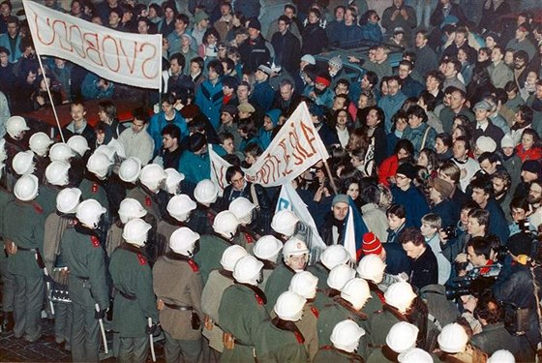
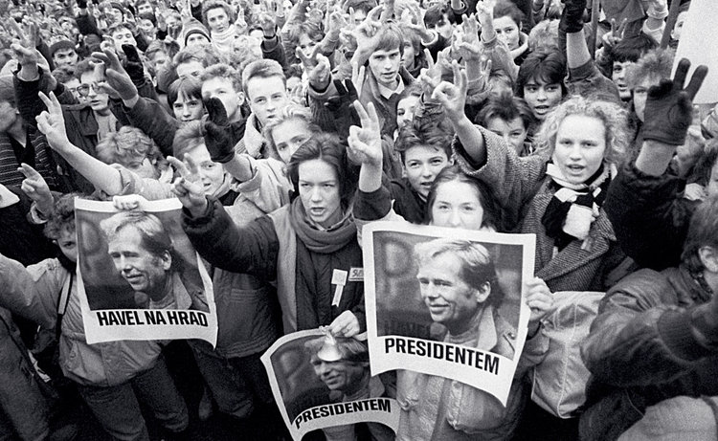
Czech Republic and emigration
We saw each other after the VELVET REVOLUTION
  17. 11. 1989

Slide 11
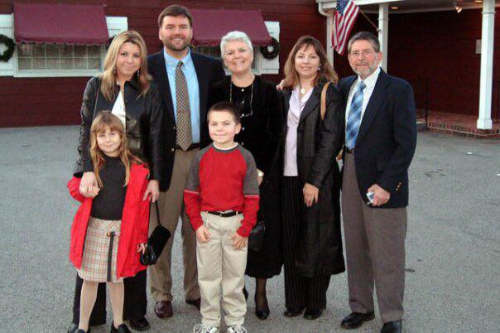
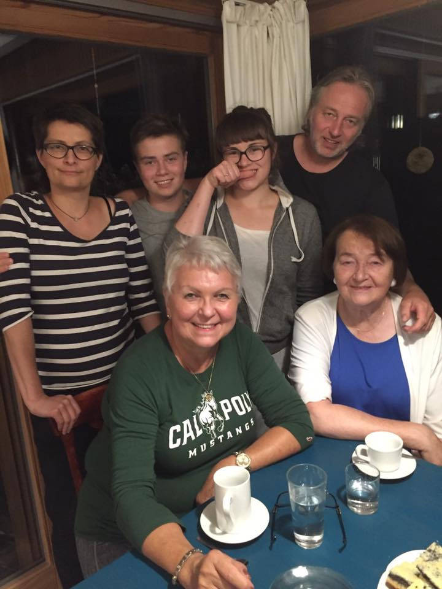
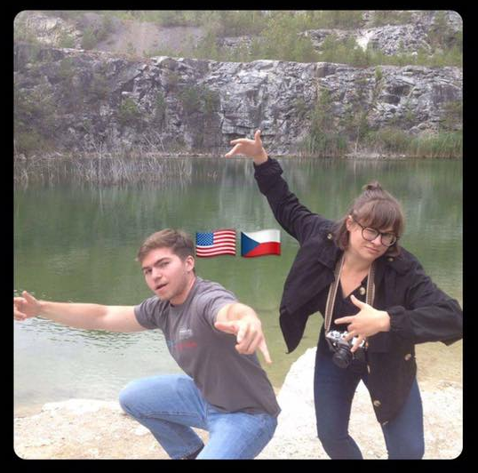
Czech Republic and emigration
In 20th century
  comunism
  Illegal migration (USA, France, Austria, West Germany, Britain)

Slide 12

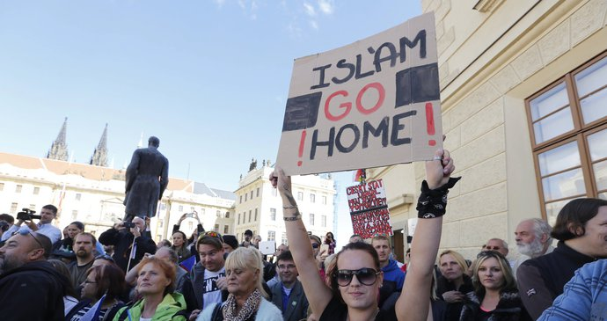
Institutes and politics
Refusing refugees
  Tomio Okamura
  SPD (Freedom and direct democracy)
„SAY NO TO ISLAM“
„SAY NO TO TERRORISTS“

Slide 13
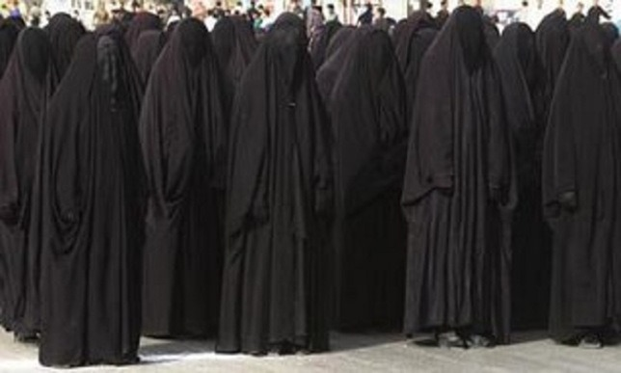

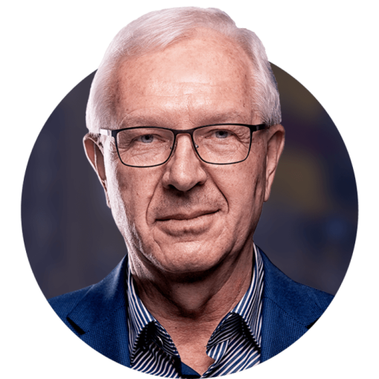
Institutes and politics
Refusing refugees
  Miloš Zeman, Czech president
  Election 2018
„STOP IMMIGRANTS AND DRAHOŠ“

Slide 14

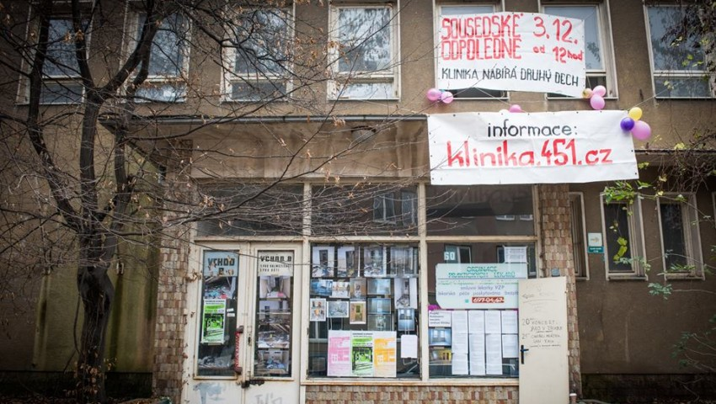

Institutes and politics
Refusing refugees
  Islám v ČR nechceme (We don´t want ISLAM in Czech Rep.)
Accepting refugees
  HATE FREE culture
  Klinika autonomic centre

Slide 15


Slide 17
Zdroje
Amnesty international: Migranti a uprchlíci [online]. Praha: AMNESTY INTERNATIONAL Česká republika [cit. 2018-02-06]. Dostupné z: https://www.amnesty.cz/

